Slide 1

Toronto Pedestrian Accidents
Contributors: Emily R., Tungalagtuya N., George K., & Todd P.
Source: https://open.toronto.ca/dataset/motor-vehicle-collisions-involving-killed-or-seriously-injured-persons/
Data license: https://open.toronto.ca/open-data-license/

Slide 2

Data
Toronto Pedestrian Accident data dashboard
Years 2006-2022
Fatalities and Injuries
Dropdown feature to select an individual year
Showcases the location where an accident occurred
Line chart for the number of accidents per month
Click on event for the following information:
District
Date
Injury
Road Conditions
Data pulled 8/3/2023 Geojson API (CSV has 7355 rows, 57 columns of data)
Challenges: Initial dataset was not a Geojson. We spent a whole entire class finding a set what was geojson and had enough columns of data to perform an analysis

Slide 3
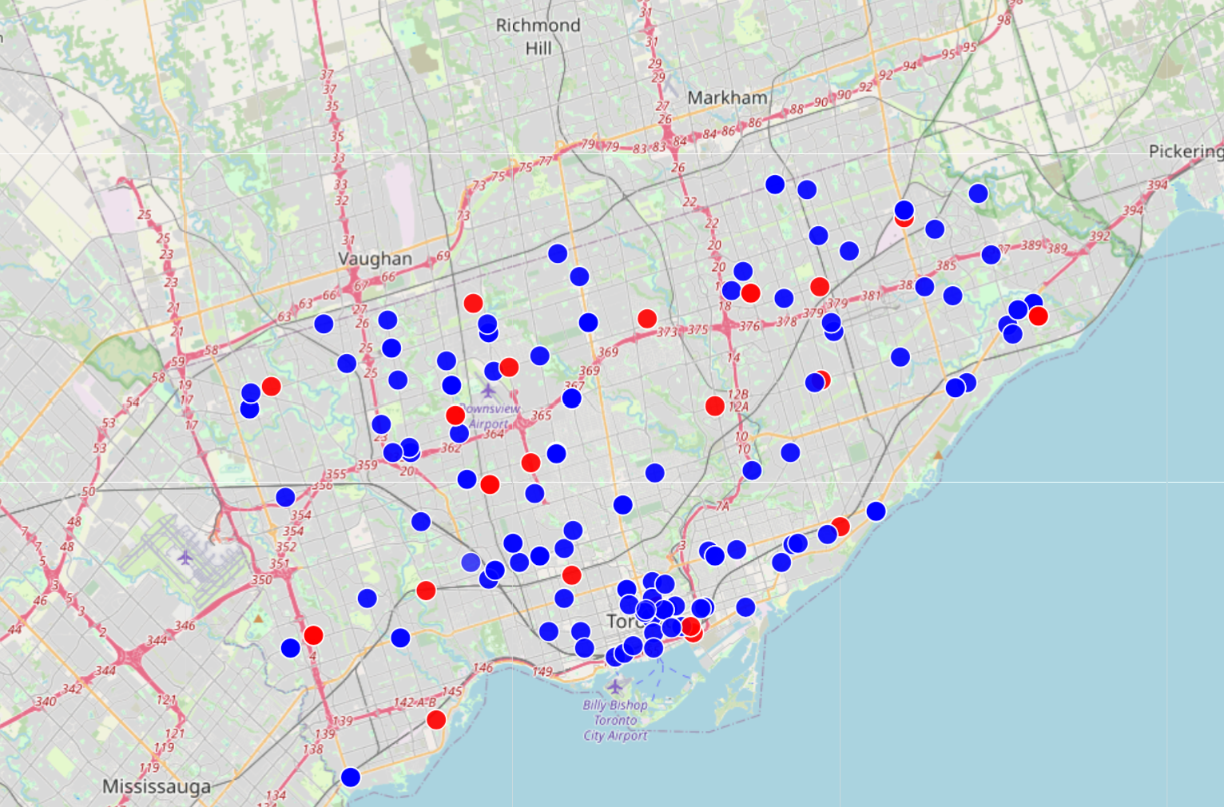
goals
Create a leaflet map with Pedestrian data (color coded – red for fatal accident, blue for non-fatal)
Dropdown for year (all visualizations change to reflect the year selection)

Slide 4
Donut/Pie chart that shows the fatal accidents based on the road surface conditions (dry, wet, ice, slush, loose snow, other)

Slide 5
Line Graph to show accident count by month
Challenges: We could not get a leaflet map AND charts to work together on the dashboard

Slide 6
Donut/Pie chart that shows the fatal accidents based on the road surface conditions (dry, wet, ice, slush, loose snow, other)

